Slide 1


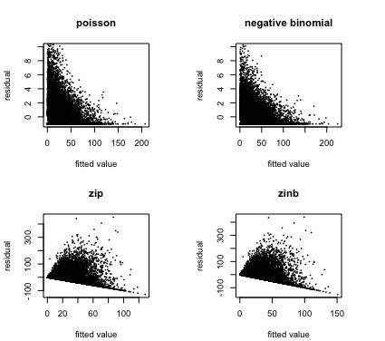
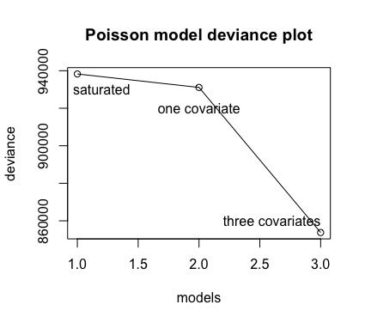
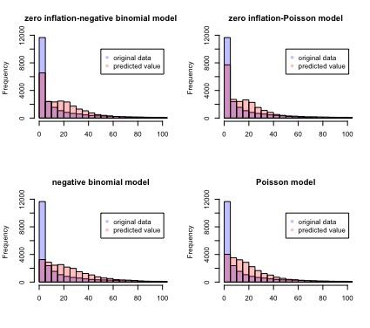
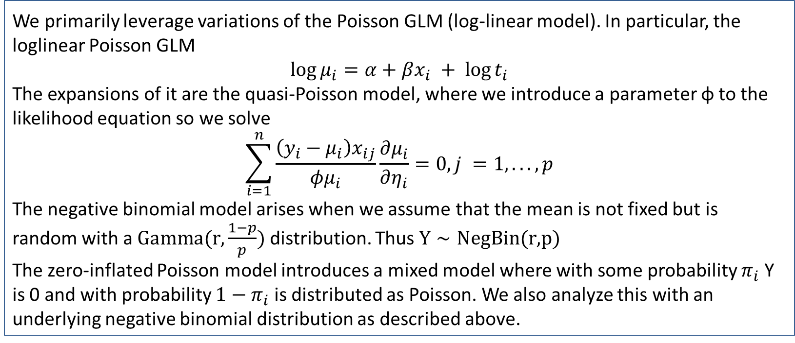
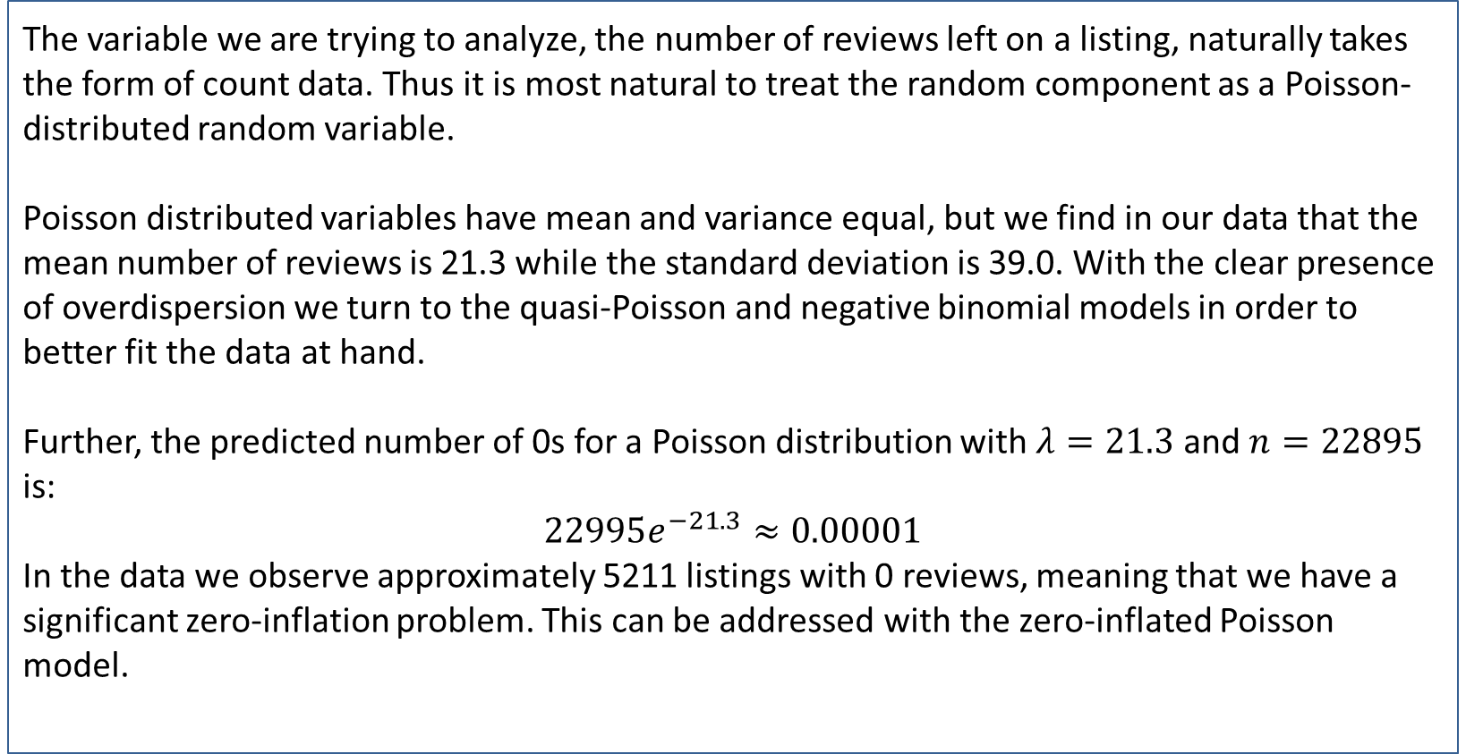
Regression Modeling Using Airbnb Data of Melbourne
Group: 3 Sigma
REPLACE THIS BOX WITH YOUR ORGANIZATION’S
HIGH RESOLUTION LOGO
Xixi Chen; Lixian Chen; George Liu; Yuhao Wang
Columbia University
Abstract
Methods and Materials
Model | Predicted # of zeros | Variance
Poisson | 760 | 19.71
Zero-inflated Poisson | 5265 | 15.73
Negative Binomial | 559 | 17.96
Zero-inflated Negative Binomial | 4219 | 23.43
We analyze a dataset drawn from AirBnB listings in Melbourne, Australia. In order to understand the drivers of conversion and engagement as measured by review count and predict the number of reviews that a listing is able to generate, we attempt to fit a loglinear model (Poisson GLM) as well as variations in order to deal with overdispersion and zero inflation in the data given a set of predictors.
In particular, because we are not privy to data about bookings given our data is scraped from the AirBnB site, we leverage factors that are likely to be predictors of historic conversion such as price, Instant Book, and availability. We also consider other variables such as months listed and property type that may have effects on reviews independent of conversion.
We primarily leverage variations of the Poisson GLM (log-linear model). In particular, the loglinear Poisson GLM
$$\log{μ_{i}}=α+βx_{i} + \log{t_{i}}$$
The expansions of it are the quasi-Poisson model, where we introduce a parameter φ to the likelihood equation so we solve
$$\sum_{i=1}^{n}{\frac{\left(y_{i}−μ_{i}\right)x_{ij}}{φμ_{i}}\frac{∂μ_{i}}{∂η_{i}}}=0, j =1, ..., p$$
The negative binomial model arises when we assume that the mean is not fixed but is random with a $\text{Gamma}\text{(}\text{r}\text{,}\frac{1−p}{p})$ distribution. Thus $Y∼\text{NegBin}\text{(}\text{r}\text{,}\text{p}\text{)}$
The zero-inflated Poisson model introduces a mixed model where with some probability $π_{i}$ Y is 0 and with probability $1−π_{i}$ is distributed as Poisson. We also analyze this with an underlying negative binomial distribution as described above.
Chart 1. Residual plots for final models
Chart 1. Residual plots for final models
Introduction
Results
Model Output
The variable we are trying to analyze, the number of reviews left on a listing, naturally takes the form of count data. Thus it is most natural to treat the random component as a Poisson-distributed random variable.
Poisson distributed variables have mean and variance equal, but we find in our data that the mean number of reviews is 21.3 while the standard deviation is 39.0. With the clear presence of overdispersion we turn to the quasi-Poisson and negative binomial models in order to better fit the data at hand.
Further, the predicted number of 0s for a Poisson distribution with $λ=21.3$ and $n=22895$ is:
$$22995e^{−21.3}≈0.00001$$
In the data we observe approximately 5211 listings with 0 reviews, meaning that we have a significant zero-inflation problem. This can be addressed with the zero-inflated Poisson model.
We tested the Poisson, negative binomial Poisson, quasi-Poisson, zero-inflated Poisson, zero-inflated negative binomial models. We also compared Poisson models with 0 predictors, 1 predictor, and 3 predictors.
For the quasi-Poisson, due to irregular outputs with an extremely high predicted φ value, we decided to not utilize this model.
We then compared the models using the Vuong test since we are comparing non-nested models
The results showed clear advantages to both the negative binomial and zero-inflated models, with the zero-inflated negative binomial being the clear winner. All Vuong test results are summarized in the table below.
Call:
zeroinfl(formula = number_of_reviews ~ price + availability_365 + instant_bookable + offset(log(months)),
data = listings_joined, dist = "negbin")
Pearson residuals:
Min 1Q Median 3Q Max
-0.8221 -0.6355 -0.4021 0.3047 440.1621
Count model coefficients (negbin with log link):
Estimate Std. Error z value Pr(>|z|)
(Intercept) 3.993e-02 1.846e-02 2.163 0.0306 *
price -5.161e-04 7.039e-05 -7.333 2.25e-13 ***
availability_365 8.291e-04 7.478e-05 11.087 < 2e-16 ***
instant_bookablet 5.285e-01 1.765e-02 29.943 < 2e-16 ***
Log(theta) -2.863e-01 1.226e-02 -23.358 < 2e-16 ***
Zero-inflation model coefficients (binomial with logit link):
Estimate Std. Error z value Pr(>|z|)
(Intercept) -4.5297124 0.0372372 -121.645 < 2e-16 ***
price 0.0008192 0.0001209 6.776 1.23e-11 ***
availability_365 -0.0026005 0.0001724 -15.086 < 2e-16 ***
instant_bookablet 0.1995159 0.0426965 4.673 2.97e-06 ***
---
Signif. codes: 0 '***' 0.001 '**' 0.01 '*' 0.05 '.' 0.1 ' ' 1
Theta = 0.751
Number of iterations in BFGS optimization: 15
Log-likelihood: -8.057e+04 on 9 Df
Table 1. Vuong test results comparing different models
Conclusions
Models Compared (winner in italics) | Vuong z-statistic
Poisson and Negative Binomial | 79.34
Poisson and Zero-inflated Poisson | 79.74
Zero-inflated Poisson and Negative Binomial | 62.27
Zero-inflated Negative Binomial and Negative Binomial | 36.45
Zero-inflated Poisson and Zero-inflated Negative Binomial | 63.45
We were able to produce a model which we felt had reasonable predictive power, in which we see a negative relationship between price and reviews, but a positive one in availability and Instant Book status. None of the coefficients provides a shocking conclusion, so this model is one that we would feel comfortable with.
However as we can see from the histogram there are still areas which can be refined. For instance, we can see that our model provides higher weights in the mid-range of review count. We also observe that there are certain residuals that are quite large.
The natural next steps are to understand the points with large residuals to see whether they have excessive leverage, and to refine our understanding of the number of low-review count and whether we could introduce additional variables to improve the fit.
Figure 1. Deviance Comparison of Poisson Models
Figure 2. Histogram of Predicted values vs Original Data
Contact
References
Lixian Chen
Department of Statistics, Columbia University
Email: lc3359@Columbia.edu
Tyler Xie. (2019). Melbourne AirBnB Open Data. (Version 10) [Data files]. Retrieved from https://www.kaggle.com/tylerx/melbourne-airbnb-open-data/
Vuong, Quang H. (1989). "Likelihood Ratio Tests for Model Selection and non-nested Hypotheses". Econometrica. 57 (2): 307–333. JSTOR 1912557.
Agresti, Alan. (2012) Categorical Data Analysis (3rd ed.). Hoboken, NJ: John Wiley and Sons

